Slide 1
Introduction to Image Analysis
3D image visualisation
Robert Haase, Benoit Lombardot
Contents
Reslicing
Projections
Viewers
Volume management

Slide 2
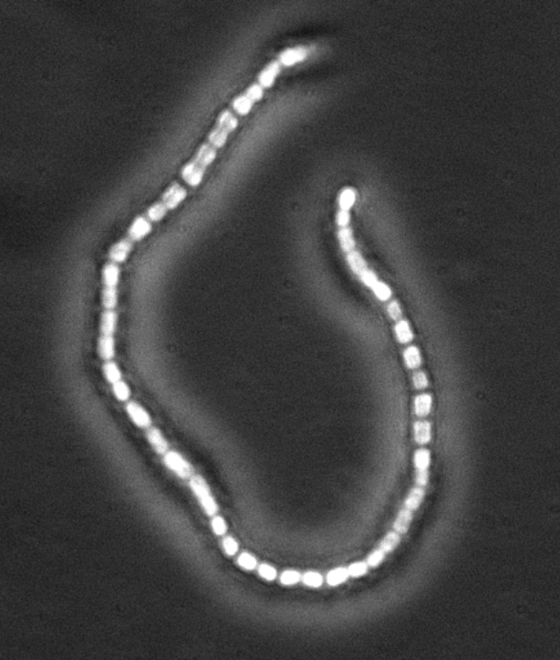
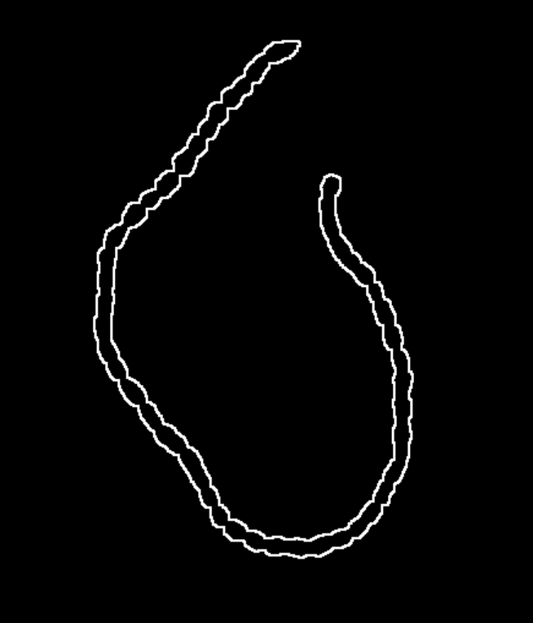
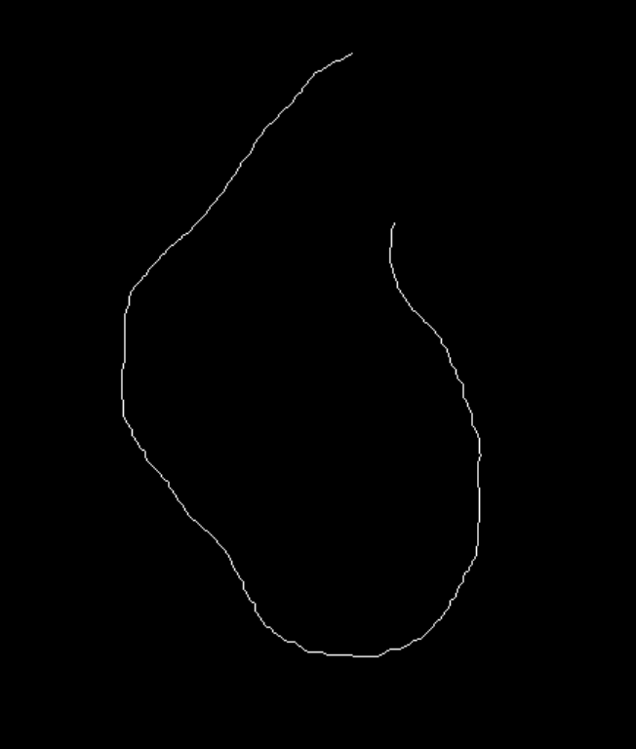
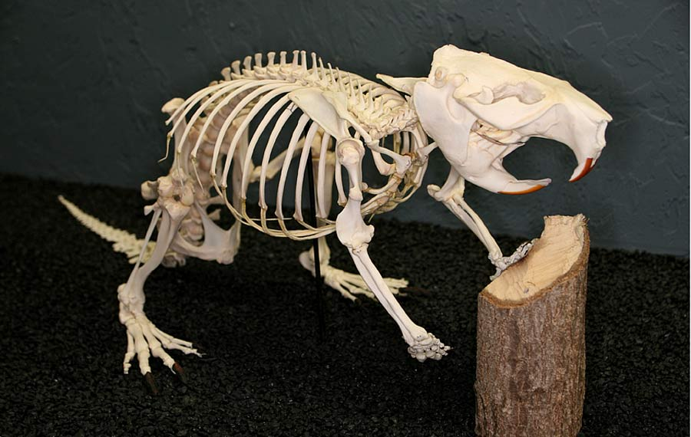
Quiz
Which image shows a skeleton?

Slide 3
Quiz
What does a rigid transformation consist of?
Rotation
Translation + Rotation
Translation + Rotation + Isometric scaling

Slide 4
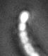

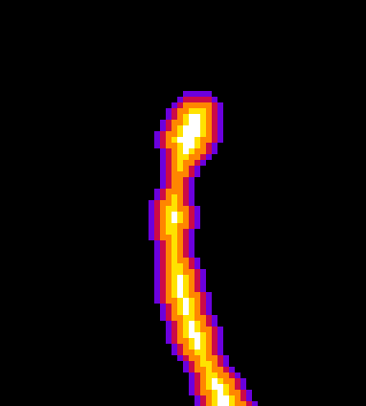

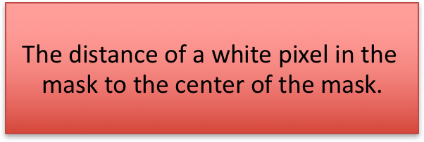
Quiz
What does the intensity of a pixel in a distance map represent?
Grey value image
Mask
Distance map
6
0
The distance of a white pixel in the mask to the closest black pixel in the mask.
$$\text{The} \text{distance} \text{of} \text{a} \text{white} \text{pixel} \text{in} \text{the} \text{mask} \text{to} \text{the} \text{center} \text{of} \text{the} \text{mask}\text{.}$$

Slide 5
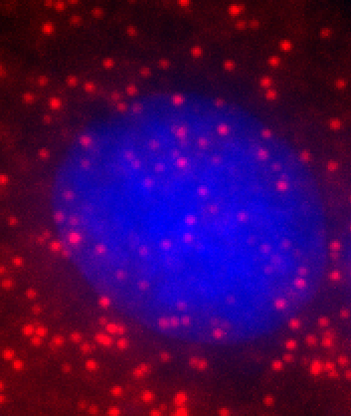
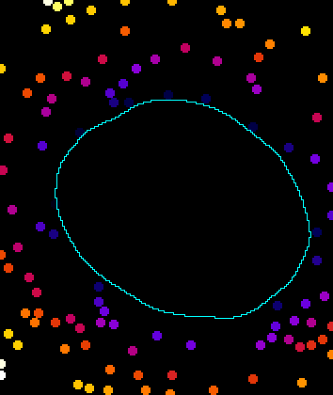
Quiz
What does the signal intensity in the image on the right numerate?
80
0
Signal intensity in the red channel
Number of other objects close by
Distance of the object to the nucleus

Slide 6
Quiz
Which mask operation is visualised here?
Dilation
Erosion
Closing

Slide 7
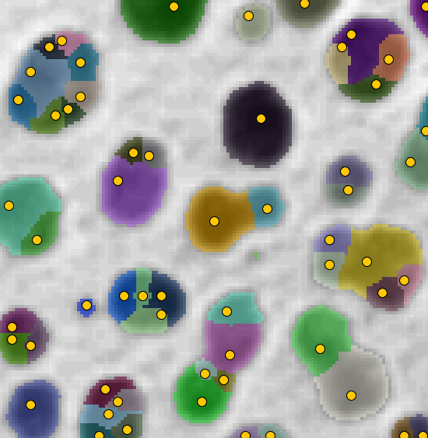
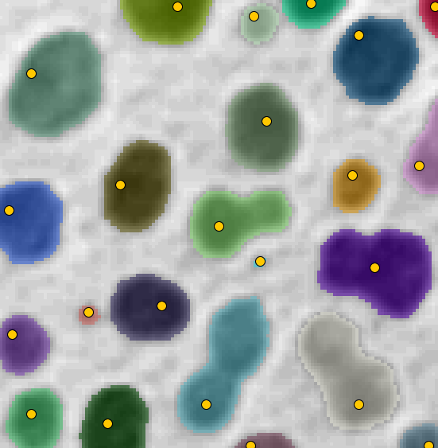
Quiz
When using the H-Watershed for object differentiation, what expresses the H-parameter?
Low H
High H
The threshold between object and background
The minimum height of a signal valley between two objects
The minimum area an object must have

Slide 8
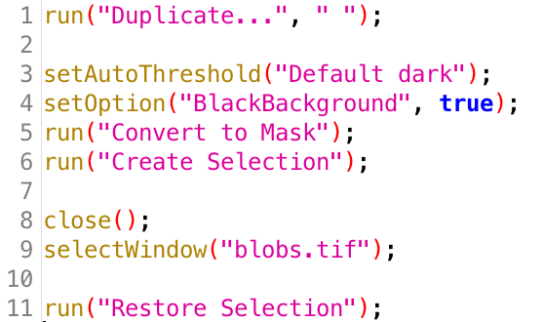
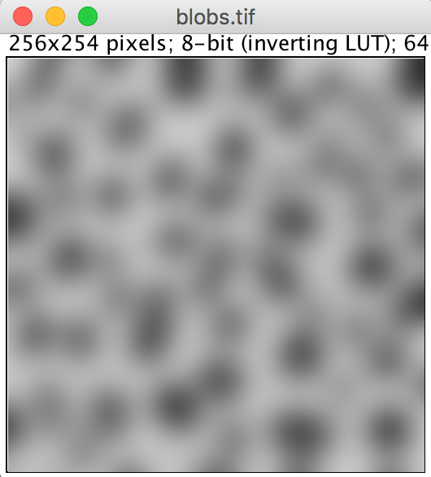
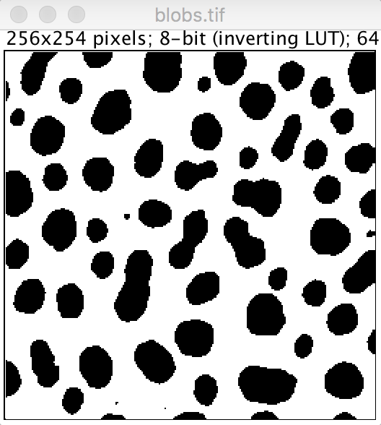
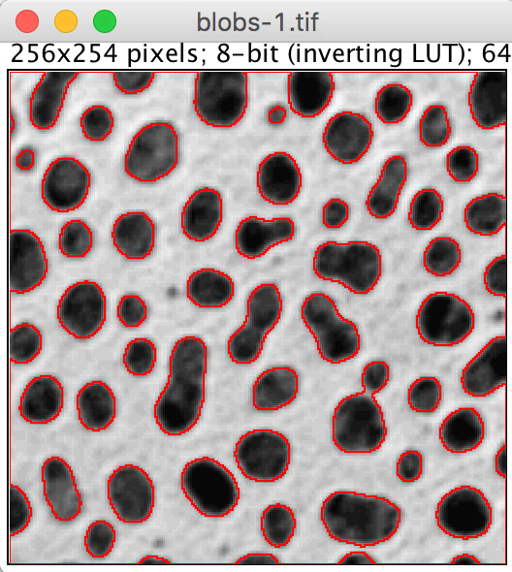
Quiz
What does this macro do with blobs.tif?

Slide 9
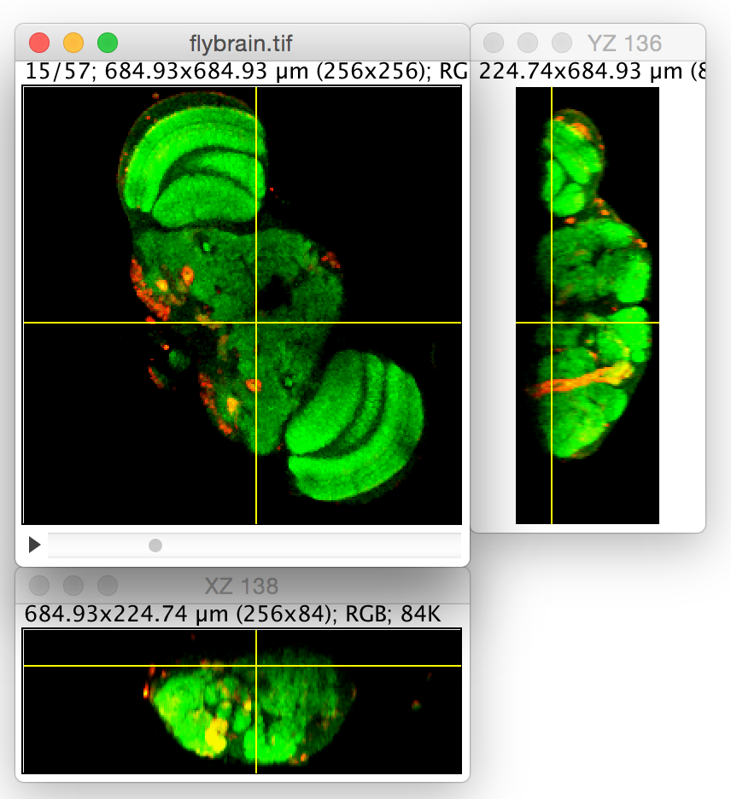
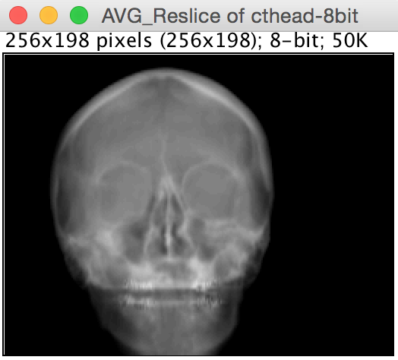
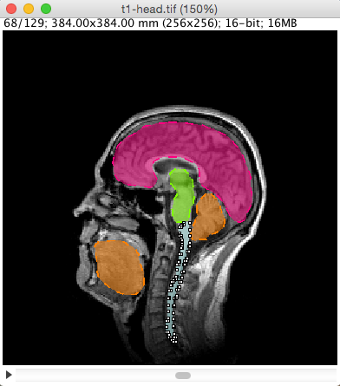
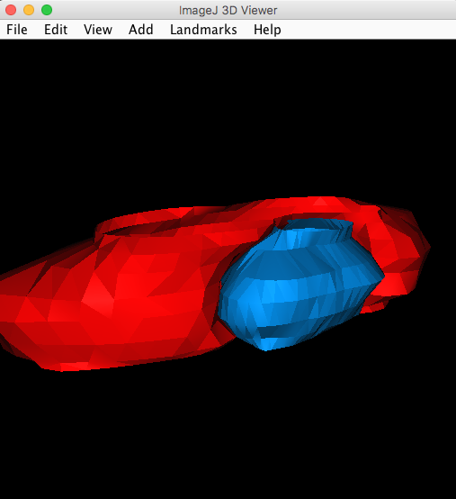
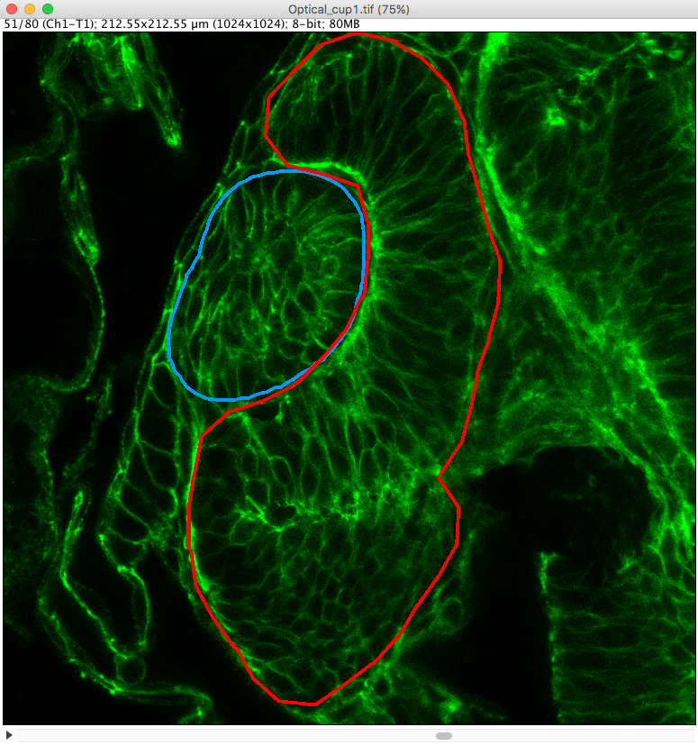
Overview
3D image visualisation
Introduction
Open images (BioFormats)
Multiview Reconstruction (Demo)
Visualisation
Reslicing
Orthogonal views
Anistropy, slice distance, slice thickness
Sampling
Projections
Viewers
ImageJ 3D Viewer
ClearVolume
BigDataViewer
Volume management
Manual segmentation
3D projection
Exercise

Slide 10

Introduction
3D image visualisation
3D images are hard to handle,
because our screen is 2D.
Potential solutions
Reslicing
Projection
Vectorization
But
Dimension reduction = information loss!
Results are produced for visualization, not for measurements!

Slide 11
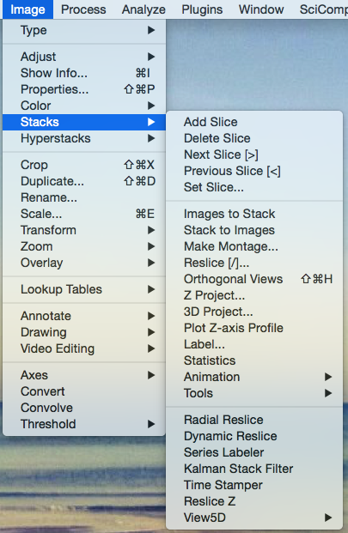
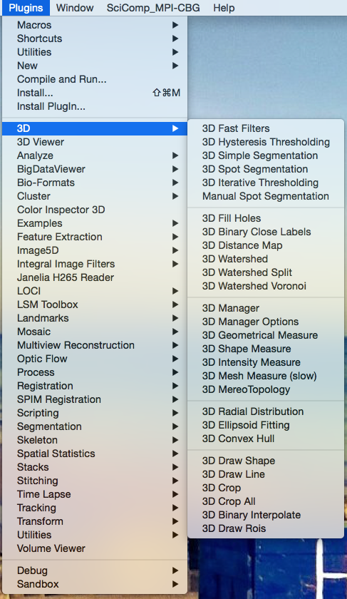
Introduction
3D image visualisation
ImageJ/Fiji were initially not made for 3D image processing, but...
http://fiji.sc/Z-functions
http://imagejdocu.tudor.lu/
doku.php?id=plugin:stacks:3d_ij_suite:start

Slide 12
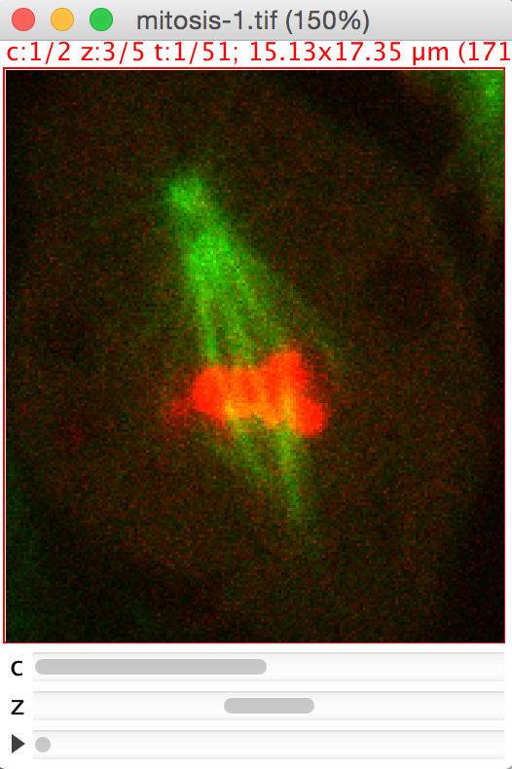
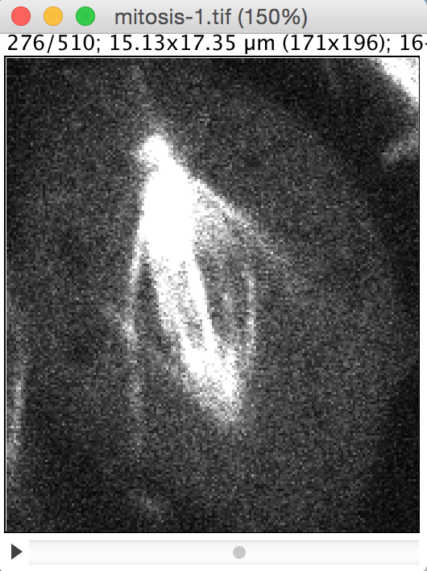
Troubleshooting: Open images
3D image visualisation
If an image stack does not appear as it should be (missing colours, wrong number of slices/frames/channels)…

Slide 13
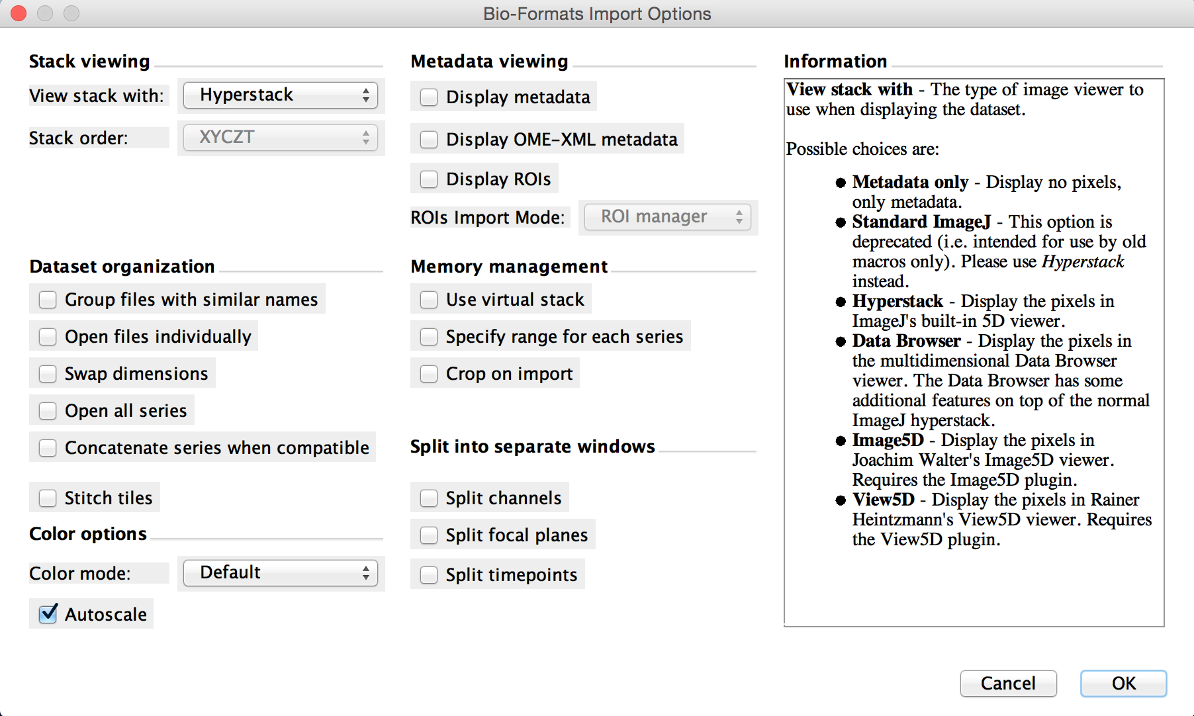
Open images: BioFormats
3D image visualisation
… consider using the BioFormats importer
File > Import > BioFormats
This also makes sense, if you try to open huge files.

Slide 14
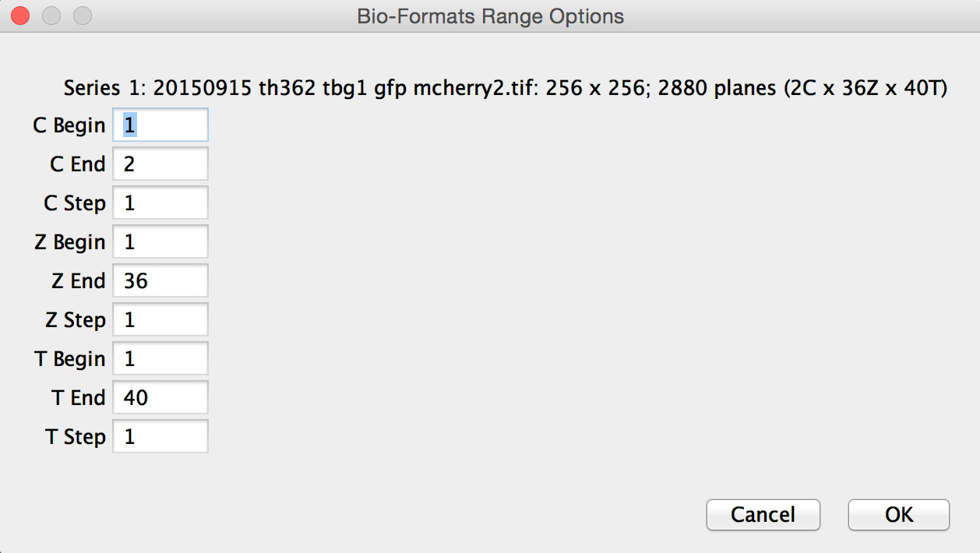
Open images: BioFormats
3D image visualisation
Configure the range of channels/slices/frames to actually load.
Channels
Slices
Time frames
More Information: http://www.openmicroscopy.org/site/products/bio-formats

Slide 15
Overview
3D image visualisation
Introduction
Open images (BioFormats)
Multiview Reconstruction (Demo)
Visualisation
Reslicing
Orthogonal views
Anistropy, slice distance, slice thickness
Sampling
Projections
Viewers
ImageJ 3D Viewer
ClearVolume
BigDataViewer
Volume management
Manual segmentation
3D projection
Exercise

Slide 16
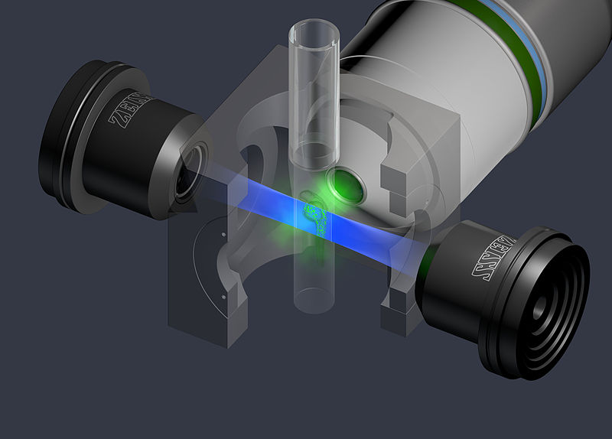
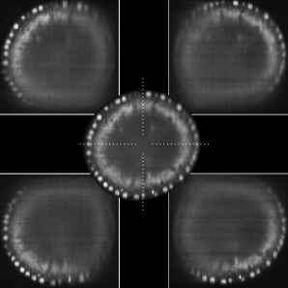
Multiview-Reconstruction
3D image visualisation
Principle of light-sheet microscopy
Image source: ZEISS Microscopy
Image source: https://sguenther.eu/science/light-sheet-microscopy/

Slide 17
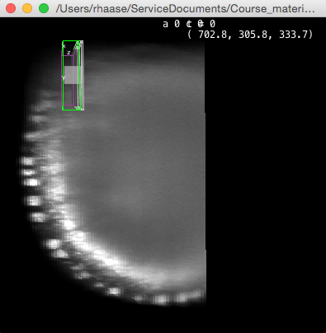
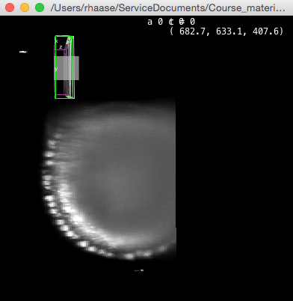
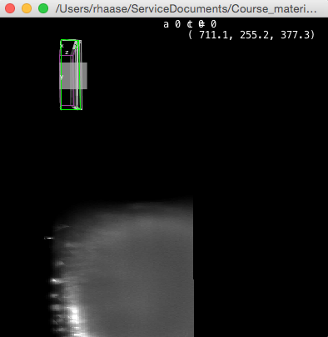
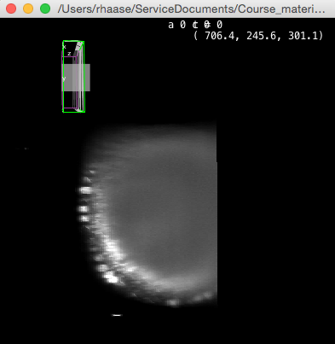
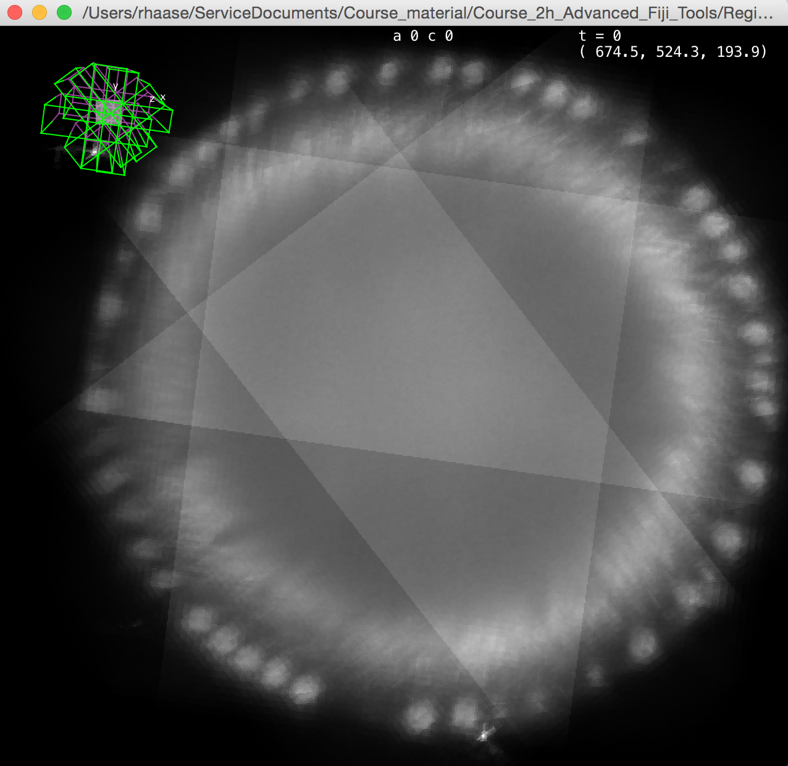
Multiview reconstruction
3D image visualisation
Before: Images from the microscope
After:
What transformation do we need to apply?
Translation
Rigid
Affine
Data source: http://fiji.sc/Multiview-Reconstruction

Slide 18
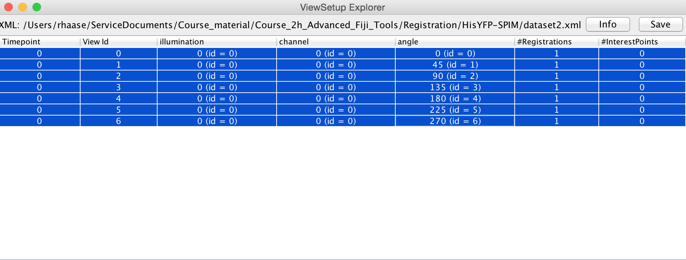
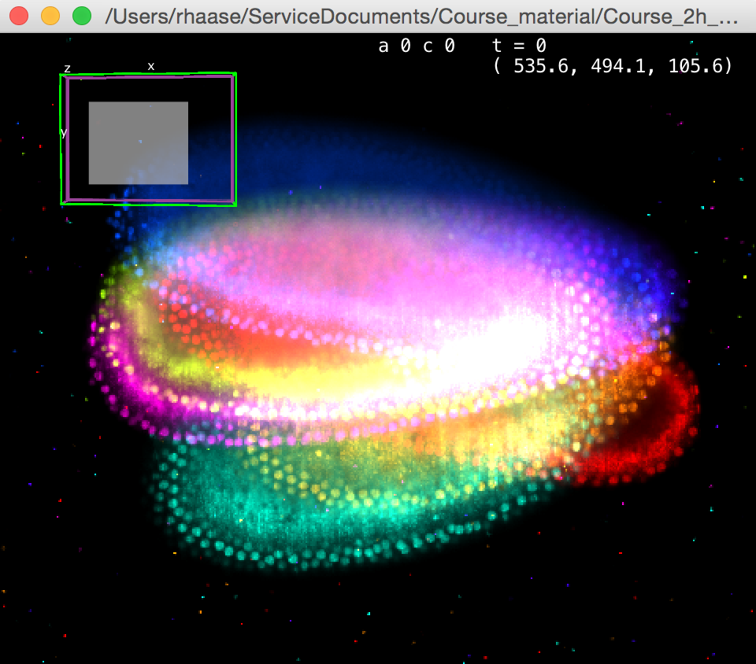
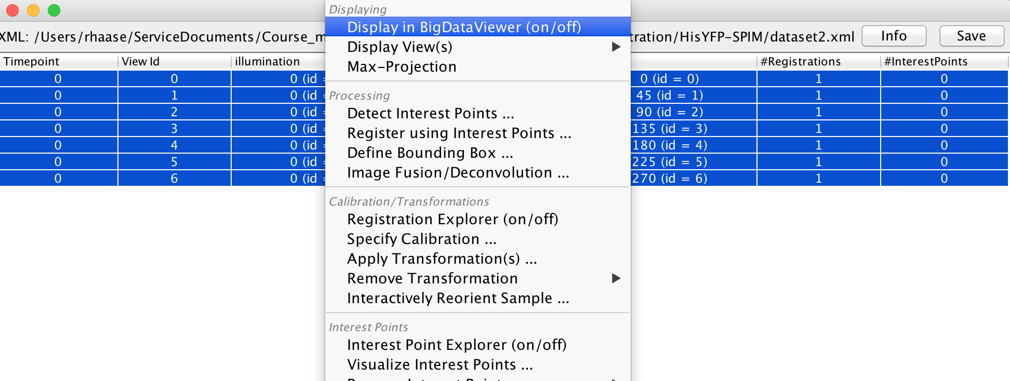
Multiview reconstruction
3D image visualisation
Demo

Slide 19
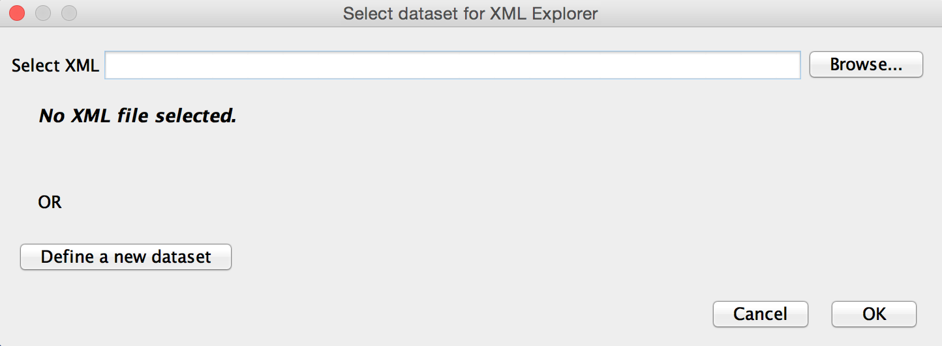
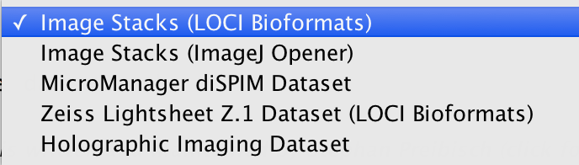
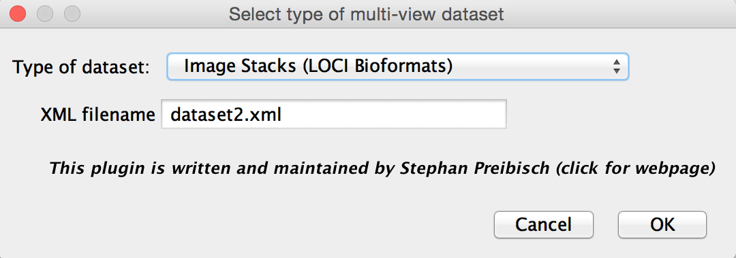
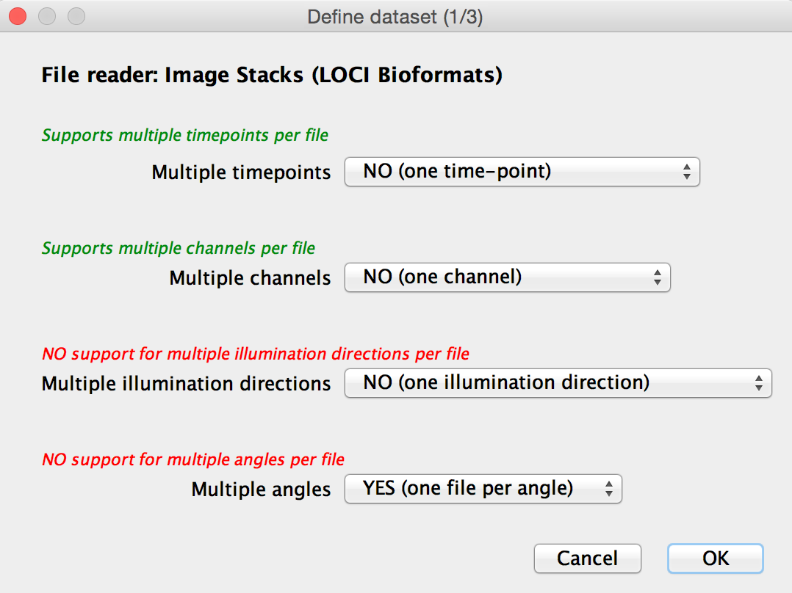
Multiview reconstruction
3D image visualisation
Plugins > Multiview Reconstruction > MultiView Reconstruction Application

Slide 20
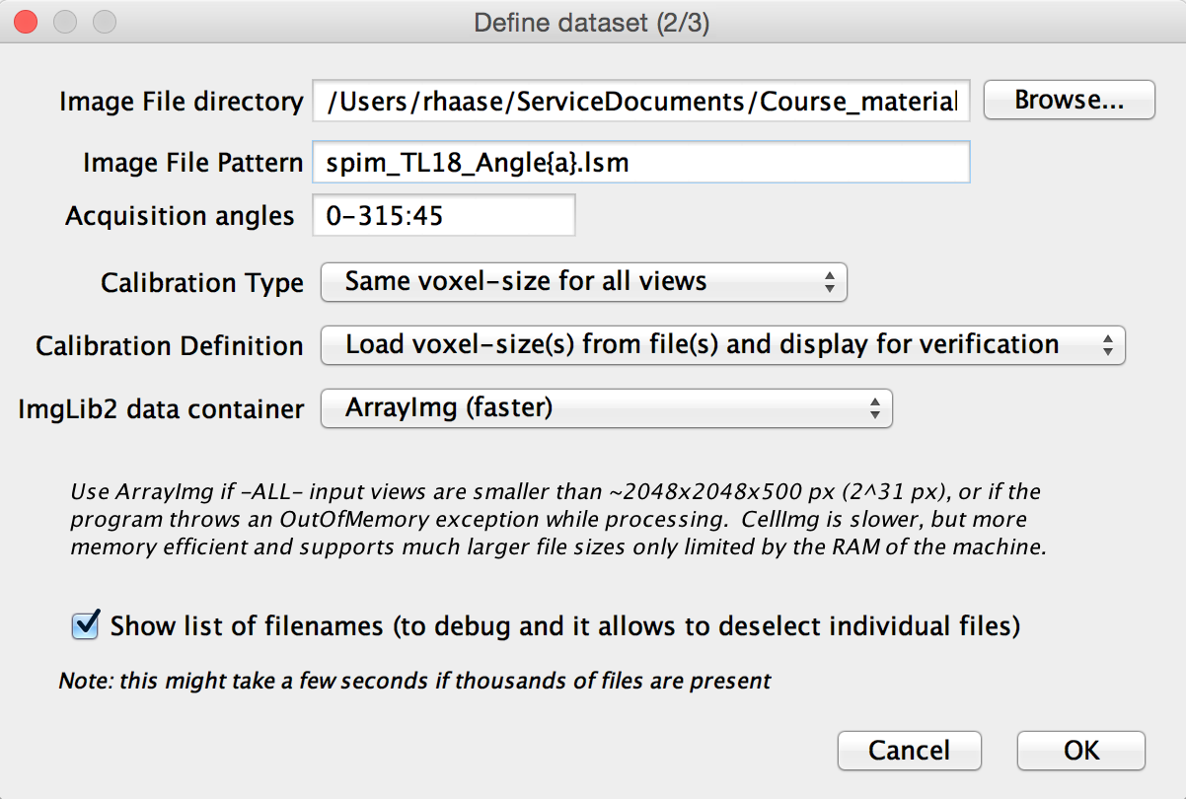
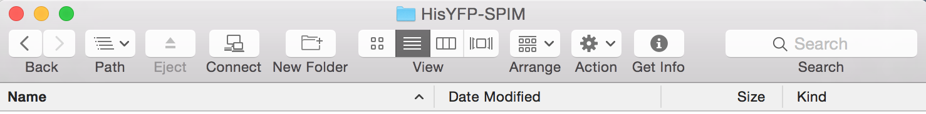
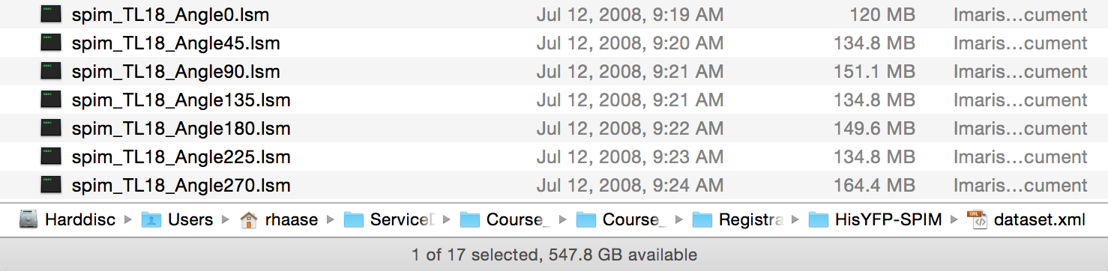
Multiview reconstruction
3D image visualisation
Enter filename with {a} as placeholder for the angle.

Slide 21
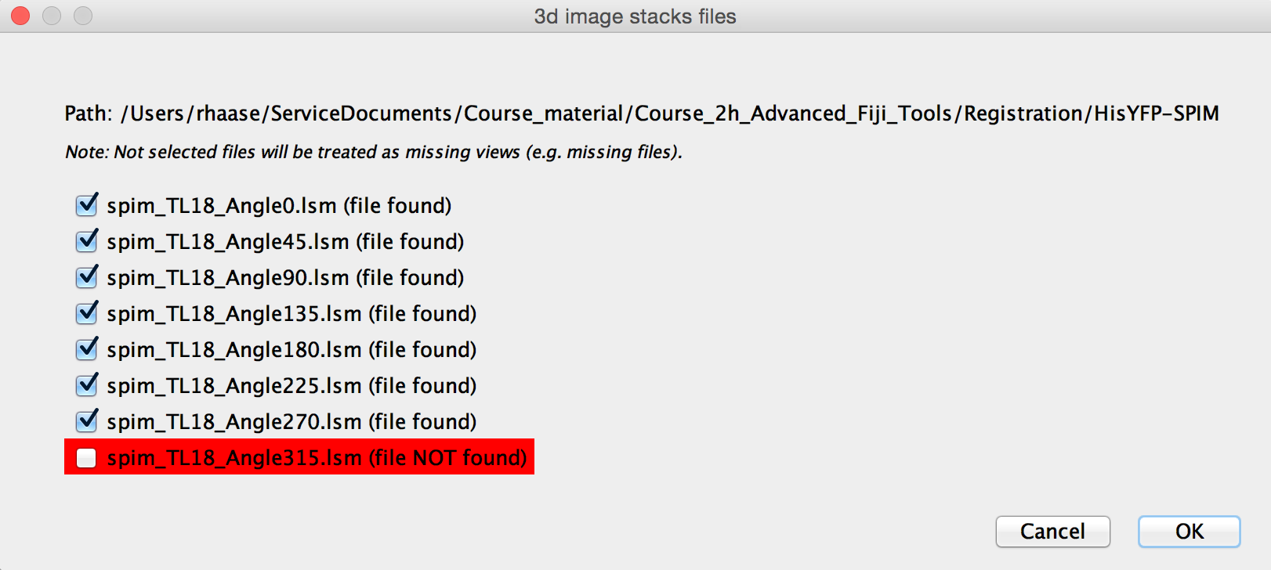
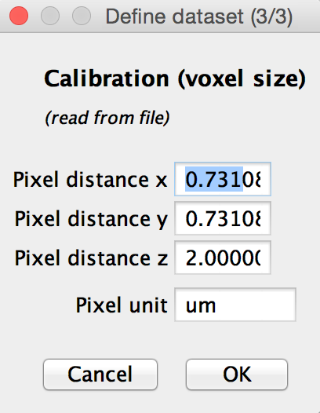
Multiview reconstruction
3D image visualisation
If files are not found, the application will notify you.

Slide 22
Multiview reconstruction
3D image visualisation
A list with all data sets will appear. Select all using SHIFT and the left mouse button.
Right-click on one and click Display in BigDataViewer

Slide 23
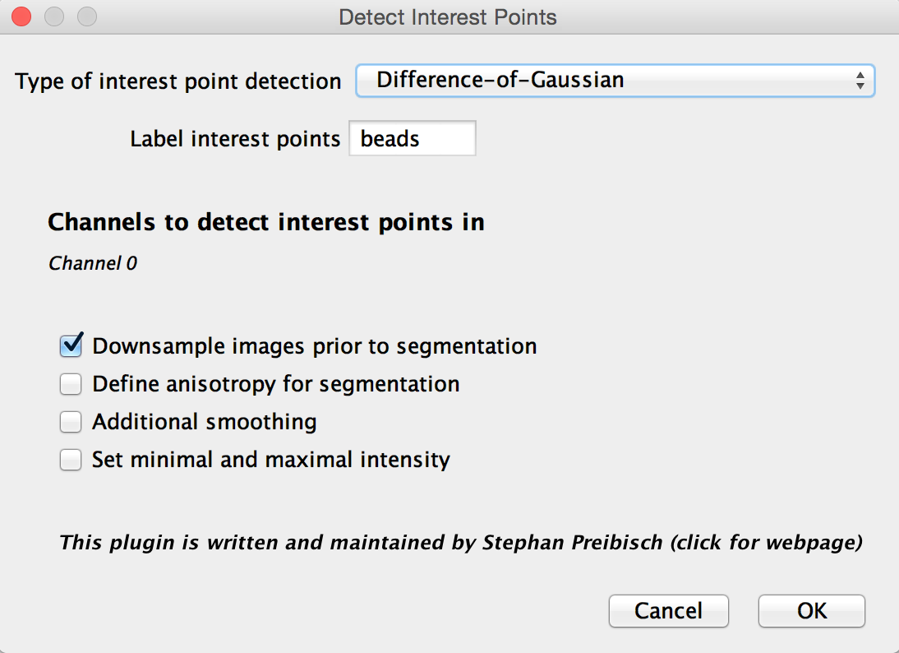
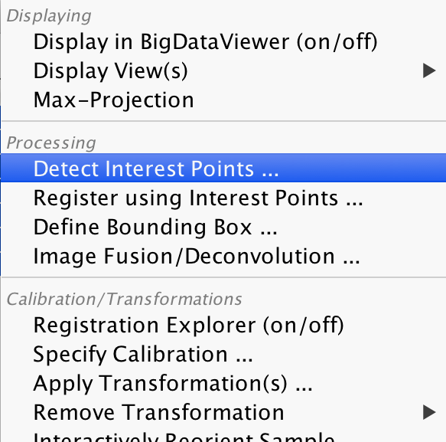
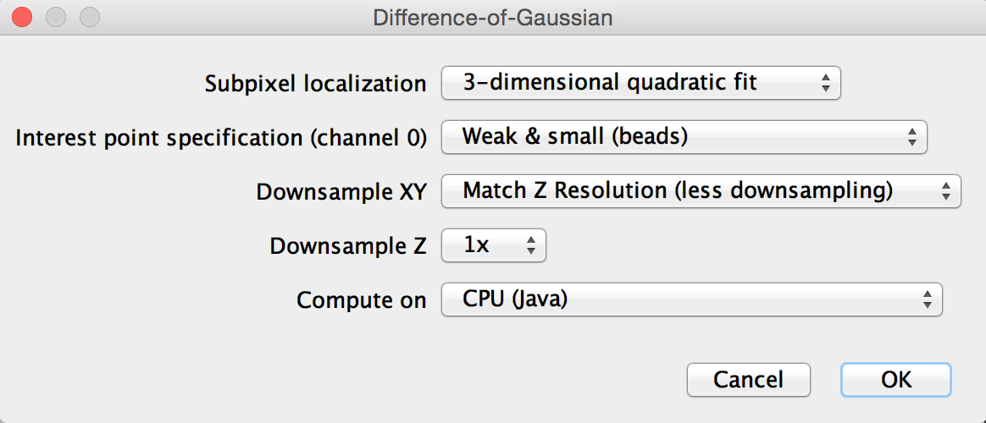
Multiview reconstruction
3D image visualisation
Detect interest Points…

Slide 24
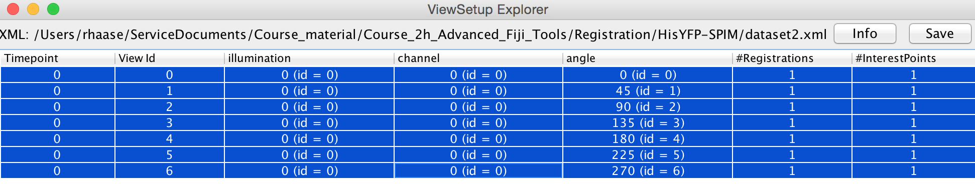
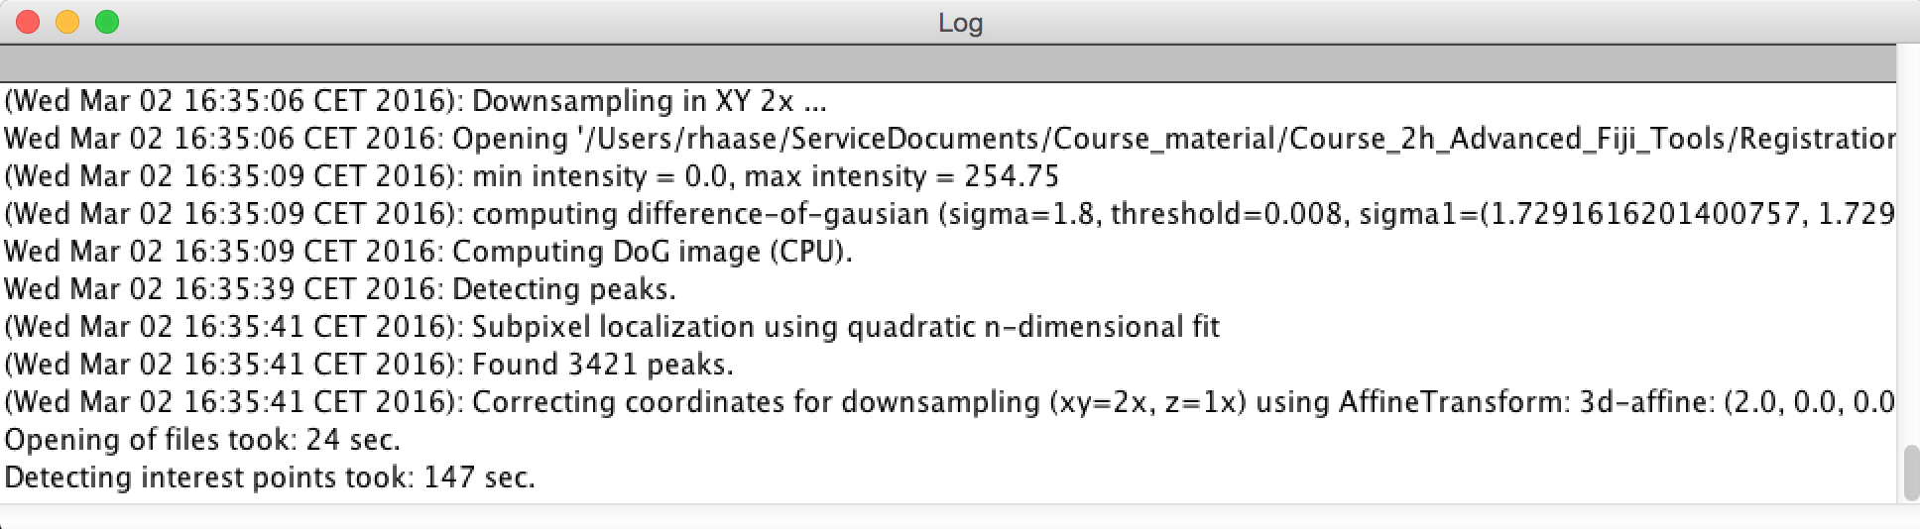
Multiview reconstruction
3D image visualisation
After that, Interest Points are available.

Slide 25




Multiview reconstruction
3D image visualisation
Register using Interest Points…

Slide 26



Multiview reconstruction
3D image visualisation
After registration finished, the view looks much better…

Slide 27


Multiview reconstruction
3D image visualisation
Image Fusion

Slide 28








Multiview reconstruction
3D image visualisation
Press SHIFT + X
Press SHIFT + Z

Slide 29

Multiview reconstruction
3D image visualisation
Choose 16bit unsigned integer if you want to spare some space

Slide 30


Multiview reconstruction
3D image visualisation
Image > Stacks > Reslice [/]…

Slide 31
Coffee break?

Slide 32
Overview
3D image visualisation
Introduction
Open images (BioFormats)
Multiview Reconstruction (Demo)
Visualisation
Reslicing
Orthogonal views
Anistropy, slice distance, slice thickness
Sampling
Projections
Viewers
ImageJ 3D Viewer
ClearVolume
BigDataViewer
Volume management
Manual segmentation
3D projection
Exercise

Slide 33










Reslicing
3D image visualisation
Image > Stacks > Reslice [/]…

Slide 34



Reslicing
3D image visualisation
Image > Stacks > Dynamic reslice
Move the yellow line by dragging its centre point.
This also works with segmented lines
If the result appears strange try to split channels first!

Slide 35
Orthogonal views
3D image visualisation
Image > Stacks > Orthogonal Views
Move the yellow cross by dragging its centre point.

Slide 36




Anisotropy
3D image visualisation
An-iso-tropy, from Greek:
ἀν- (not)
ἴσος isos (equal)
τρόπος tropos (rotation, direction)
Not the same in any direction
Usually in 3D image processing:
Image analysts love to have isotropic voxels, but it’s often not possible.
$$l_{z}$$
$$l_{y}$$
$$l_{x}=l_{y}≠l_{z}$$
$$l_{x}$$

Slide 37




Anisotropy
3D image visualisation
Voxel size has immediate impact on image quality and thus, on processing / analysis results.
1:1
250 x 250 px
1:2
250 x 125 px
1:5
250 x 50 px
1:10
250 x 25 px

Slide 38


Slice distance versus slice thickness
3D image visualisation
What you may have measured using microscopy:
What you see when processing 3D images:
$$z$$
$$z$$
$$z$$
$$x$$
$$x$$
$$x$$
Slice distance and slice thickness may be different, but
many image processing tools ignore that!

Slide 39



Exercise: Optimal voxel size in Z
3D image visualisation
Leave out
Depending on the voxel size in Z direction, objects may be differentiable, or not.
Exercise
Open the images in the zResolution folder
Use the tools
Image > Color > Split channels,
Image > Stacks > Reslice [/],
Image > Stacks > Dynamic Reslice and
Image > Stacks > Orthogonal Views
to determine the image with optimal voxel size.
Image source: Elena Gromberg, Tanaka Group, CRTD Dresden

Slide 40


Nyquist–Shannon sampling theorem
3D image visualisation
Voxel size in Z-dimension should at least be half the size of the object you are interested in (even better: a third).
Further reading: https://en.wikipedia.org/wiki/Nyquist-Shannon_sampling_theorem
Measure the size of a gap between cells, e.g. in a highly resolved 2D-image.
Image source: Elena Gromberg, Tanaka Group, CRTD Dresden

Slide 41

3D image visualisation
Claude E. Shannon – the father of information theory
Claude Shannon was the first who built the “Ultimate machine”, based on an idea by Marvin Minsky.
Source: http://gifsoup.com/view/4292482/shannon-s-ultimate-machine.html

Slide 42








Quiz
3D image visualisation
We took this 2D image of our sample and did some distance measurements. Now we would like to go for 3D imaging. What would be a good slice distance configuration?
$$1.5μm$$
$$6 μm$$
$$9 μm$$
Image source: Jaydeep Sidhaye, Norden lab, MPI CBG
$$0.207566μm$$
$$0.5μm$$
$$3μm$$

Slide 43








Projections
3D image visualisation
Image > Stacks > Reslice [/]...
Image > Stacks > Z-Project...
Data source: University of North Carolina Volume Rendering Test Data Set, downloaded from https://graphics.stanford.edu/data/voldata/

Slide 44



Projections
3D image visualisation
In some cases, maximum projections make more sense...
Image source: Akanksha Jain, Tomancak lab, MPI CBG

Slide 45
Overview
3D image visualisation
Introduction
Open images (BioFormats)
Multiview Reconstruction (Demo)
Visualisation
Reslicing
Orthogonal views
Anistropy, slice distance, slice thickness
Sampling
Projections
Viewers
ImageJ 3D Viewer
ClearVolume
BigDataViewer
Volume management
Manual segmentation
3D projection
Exercise

Slide 46





ImageJ 3D Viewer
3D image visualisation
[Menu Image > Color > Split channels]
Menu Plugins > 3D Viewer
Menu Add > From image

Slide 47
ImageJ 3D Viewer
3D image visualisation
Click and move the mouse to turn perspective. This depends on where you click!
Hold the SHIFT key while moving to move the view in plane
Use the mouse wheel to zoom in

Slide 48

ClearVolume
3D image visualisation
Menu Plugins > ClearVolume > Open In ClearVolume

Slide 49




ClearVolume
3D image visualisation
Hint: If you want to improve colour visualisation (LUT) change the type of image to RGB Color, before you open ClearVolume

Slide 50




Short excurse: ImageJ/FIJI community
3D image visualisation
How to report about a bug in the right way:
What software do you use?
What file did you work on?
Where did you click?
What was the error message?
Be kind!
You may get feedback quite soon (in this case after 20 minutes).

Slide 51



BigDataViewer
3D image visualisation
Menu Plugins > Big Data Viewer > Open Current Image

Slide 52
Exercise: Manual Counting
3D image visualisation
Open “Spheroid.tif”
Use the viewers
Plugins
BigDataViewer
3D Viewer
ClearVolume
How many cells express the green marker?
18 big ones, 4-5 very small ones
Image source: Elena Gromberg, Tanaka Group, CRTD Dresden

Slide 53
Overview
3D image visualisation
Introduction
Open images (BioFormats)
Multiview Reconstruction (Demo)
Visualisation
Reslicing
Orthogonal views
Anistropy, slice distance, slice thickness
Sampling
Projections
Viewers
ImageJ 3D Viewer
ClearVolume
BigDataViewer
Volume management
Manual segmentation
3D projection
Exercise

Slide 54



Volume management
3D image visualisation
Volume manager tool for 3D region management
Goal:
Outlining,
managing,
measuring,
visualisation of 3D objects
Vectorisation (Discrete voxel data -> continuous vector data)
Developed in our facility
Feedback on usability very welcome!

Slide 55


Manual segmentation
3D image visualisation
SCF > Segmentation > Volume Manager

Slide 56


Manual segmentation: Polygon tool
3D image visualisation
Outline using the polygon tool along the edge of the structure to outline.
Double-click when finished.
pro: outlining is fast
con: outline may appear jerky

Slide 57

Manual segmentation: the Brush tool
3D image visualisation
Outline using the brush tool by painting the whole volume
pro: outline appears smooth
con: outlining may take a bit longer

Slide 58

Manual segmentation: the Brush tool
3D image visualisation
ADD pixels to an ROI:
Approach it from inside
Alternatively: hold SHIFT
ROI
+
+
Image source: Daniela Vorkel, EM facility, MPI CBG

Slide 59
Manual segmentation: the Brush tool
3D image visualisation
REMOVE pixels from an ROI:
Approach it from outside
Alternatively: hold ALT
ROI
+
+
Image source: Daniela Vorkel, EM facility, MPI CBG

Slide 60
Manual segmentation: the Brush tool
3D image visualisation
Hold the CMD_{MacOS} / CTRL_{Windows/Linux} key to change the size of the brush
ROI
+
+
+
Image source: Daniela Vorkel, EM facility.
Hold CMD + click

Slide 61




Manual segmentation
3D image visualisation
outline in one slice
outline in another slice
Intermediate slices will be outlined/interpolated automatically (dotted line)
Correct interpolated slices until the whole volume appears correctly outlined.

Slide 62

Manual segmentation
3D image visualisation
outline in one slice
outline in another slice
interpolated slice (dotted line)
Key slices
Switch between key slices, create and delete them

Slide 63


Naming objects
3D image visualisation
Consider naming objects, e.g. if they correspond to anatomical structures.

Slide 64

3D Projection
3D image visualisation
Menu Edit > Colors > Set random colors to all volumes
Menu File > Export > Send surfaces to 3D viewer

Slide 65
3D Viewer
3D image visualisation
Click and move the mouse to turn perspective. This depends on where you click!
Hold the SHIFT key while moving to move the view in plane
Use the mouse wheel to zoom in

Slide 66



Pitfalls: Volume manager
3D image visualisation
Separate objects should be outlined as separate objects

Slide 67


Exercise: 3D visualisation
3D image visualisation
Outline the optical cup of the zebrafish in the image files
Optical_cup1.tif
Optical_cup2.tif
Use the polygon tool
Use the brush tool
Press ALT, SHIFT and CMD/CTRL to test its functionalities.
Visualise thesurface in 3D
Image source: Jaydeep Sidhaye, Norden lab

Slide 68

Exercise solution
3D image visualisation
Optical_cup2.tif
Optical_cup1.tif
Image source: Jaydeep Sidhaye, Norden lab

Slide 69

Summary
3D image visualisation
Picking the right imaging parameters
Multiview reconstruction
Manual 3D outlining & visualisation
$$1.5μm$$
$$6 μm$$
$$9 μm$$

